Slide 1
File-System Interface
File Concept
Access Methods
Directory Structure
File System Mounting
File Sharing
Protection
Dr. Hitendra Garg, Professor, GLA University

Slide 2

File Concept
Named collection of related information stored on secondary storage device.
Data can not be written to secondary storage unless they are written within file.
Contiguous logical address space
Types:
  Data
    numeric
    character
    binary
  Program
Dr. Hitendra Garg, Professor, GLA University

Slide 3
File Attributes
Name – only information kept in human-readable form.
Type – needed for systems that support different types.
Location – pointer to file location on device.
Size – current file size.
Protection – controls who can do reading, writing, executing.
Time, date, and user identification – data for protection, security, and usage monitoring.
Information about files are kept in the directory structure, which is maintained on the disk.
Dr. Hitendra Garg, Professor, GLA University

Slide 4
File Operations
Create
Write
Read
Reposition within file – file seek
Delete
Truncate
Open(F_{i}) – search the directory structure on disk for entry F_{i}, and move the content of entry to memory.
Close (F_{i}) – move the content of entry F_{i} in memory to directory structure on disk.
Dr. Hitendra Garg, Professor, GLA University

Slide 5

File Types – Name, Extension
Dr. Hitendra Garg, Professor, GLA University

Slide 6

Access Methods
Sequential Access
read next
write next
reset
no read after last write
(rewrite)
Direct Access
read n
write n
position to n
read next
write next
rewrite n
n = relative block number
Dr. Hitendra Garg, Professor, GLA University

Slide 7

Sequential-access File
Dr. Hitendra Garg, Professor, GLA University

Slide 8

Simulation of Sequential Access on a Direct-access File
Dr. Hitendra Garg, Professor, GLA University

Slide 9

Example of Index and Relative Files
Dr. Hitendra Garg, Professor, GLA University

Slide 10
Directory Structure
A collection of nodes containing information about all files.
Directory
Files
F 1
F 2
F 3
F 4
F n
Both the directory structure and the files reside on disk.
Backups of these two structures are kept on tapes.
Dr. Hitendra Garg, Professor, GLA University

Slide 11

A Typical File-system Organization
Dr. Hitendra Garg, Professor, GLA University

Slide 12
Operations Performed on Directory
Search for a file
Create a file
Delete a file
List a directory
Rename a file
Traverse the file system
Dr. Hitendra Garg, Professor, GLA University

Slide 13
Organize the Directory (Logically) to Obtain
Efficiency – locating a file quickly.
Naming – convenient to users.
  Two users can have same name for different files.
  The same file can have several different names.
Grouping – logical grouping of files by properties, (e.g., all Java programs, all games, …)
Dr. Hitendra Garg, Professor, GLA University

Slide 14

Single-Level Directory
A single directory for all users.
Naming problem
Grouping problem
Dr. Hitendra Garg, Professor, GLA University

Slide 15

Two-Level Directory
Separate directory for each user.
Path name
Can have the same file name for different user
Efficient searching
No grouping capability
Dr. Hitendra Garg, Professor, GLA University

Slide 16

Tree-Structured Directories
Dr. Hitendra Garg, Professor, GLA University

Slide 17
Tree-Structured Directories (Cont.)
Efficient searching
Grouping Capability
Current directory (working directory)
  cd /spell/mail/prog
  type list
Dr. Hitendra Garg, Professor, GLA University

Slide 18
Tree-Structured Directories (Cont.)
Absolute or relative path name
Creating a new file is done in current directory.
Delete a file
rm <file-name>
Creating a new subdirectory is done in current directory.
  mkdir <dir-name>
Example: if in current directory /mail
mkdir count
mail
prog
copy
prt
exp
count
Deleting “mail” ⇒ deleting the entire subtree rooted by “mail”.
Dr. Hitendra Garg, Professor, GLA University

Slide 19

Acyclic-Graph Directories
Have shared subdirectories and files.
Dr. Hitendra Garg, Professor, GLA University

Slide 20
Protection
File owner/creator should be able to control:
  what can be done
  by whom
Types of access
  Read
  Write
  Execute
  Append
  Delete
  List
Dr. Hitendra Garg, Professor, GLA University

Slide 21
Access Lists and Groups
Mode of access: read, write, execute
Three classes of users
RWX
a) owner access 7 ⇒ 1 1 1
RWX
b) group access 6 ⇒ 1 1 0
RWX
c) public access 1 ⇒ 0 0 1
Ask manager to create a group (unique name), say G, and add some users to the group.
For a particular file (say game) or subdirectory, define an appropriate access.
owner
group
public
chmod
761
game
Attach a group to a file
chgrp G game
Dr. Hitendra Garg, Professor, GLA University

Slide 22
File System Implementation
Dr. Hitendra Garg, Professor, GLA University

Slide 23

Layered File System
Dr. Hitendra Garg, Professor, GLA University

Slide 24

A Typical File Control Block
Dr. Hitendra Garg, Professor, GLA University

Slide 25
Directory Implementation
Linear list of file names with pointer to the data blocks.
  simple to program
  time-consuming to execute
Hash Table – linear list with hash data structure.
  decreases directory search time
  collisions – situations where two file names hash to the same location
  fixed size
Dr. Hitendra Garg, Professor, GLA University

Slide 26
Allocation Methods
An allocation method refers to how disk blocks are allocated for files:
Contiguous allocation
Linked allocation
Indexed allocation
Dr. Hitendra Garg, Professor, GLA University

Slide 27
Contiguous Allocation
Each file occupies a set of contiguous blocks on the disk.
Simple – only starting location (block #) and length (number of blocks) are required.
Random access.
Wasteful of space (dynamic storage-allocation problem).
Files cannot grow.
Dr. Hitendra Garg, Professor, GLA University

Slide 28

Contiguous Allocation of Disk Space
Dr. Hitendra Garg, Professor, GLA University

Slide 29
Linked Allocation
Each file is a linked list of disk blocks: blocks may be scattered anywhere on the disk.
block =
pointer
Dr. Hitendra Garg, Professor, GLA University

Slide 30
Linked Allocation (Cont.)
Simple – need only starting address
Free-space management system – no waste of space
No random access
Mapping
Q
LA/511
R
  Block to be accessed is the Qth block in the linked chain of blocks representing the file.
  Displacement into block = R + 1
Dr. Hitendra Garg, Professor, GLA University

Slide 31

Linked Allocation
Dr. Hitendra Garg, Professor, GLA University

Slide 32

File-Allocation Table
Dr. Hitendra Garg, Professor, GLA University

Slide 33
Indexed Allocation
Brings all pointers together into the index block.
Logical view.
index table
Dr. Hitendra Garg, Professor, GLA University

Slide 34

Example of Indexed Allocation
Dr. Hitendra Garg, Professor, GLA University

Slide 35
Indexed Allocation (Cont.)
Need index table
Random access
Dynamic access without external fragmentation, but have overhead of index block.
Mapping from logical to physical in a file of maximum size of 256K words and block size of 512 words. We need only 1 block for index table.
Q
LA/512
R
Q = displacement into index table
R = displacement into block
Dr. Hitendra Garg, Professor, GLA University

Slide 36
Indexed Allocation – Mapping (Cont.)

outer-index
index table
file
Dr. Hitendra Garg, Professor, GLA University

Slide 37
Free-Space Management
Bit vector (n blocks)
0
1
2
n-1
…
0 ⇒ block[i] free
1 ⇒ block[i] occupied
bit[i] =

Dr. Hitendra Garg, Professor, GLA University

Slide 38
Free-Space Management (Cont.)
Bit map requires extra space. Example:
block size = 2¹² bytes
disk size = 2³⁰ bytes (1 gigabyte)
n = 2³⁰/2¹² = 2¹⁸ bits (or 32K bytes)
Easy to get contiguous files
Linked list (free list)
  Cannot get contiguous space easily
  No waste of space
Grouping
Counting
Dr. Hitendra Garg, Professor, GLA University

Slide 39
Free-Space Management (Cont.)
    Set bit[i] = 1 in disk.
    Allocate block[i]
    Set bit[i] = 1 in memory
Dr. Hitendra Garg, Professor, GLA University

Slide 40

Linked Free Space List on Disk
Dr. Hitendra Garg, Professor, GLA University

Slide 41
Protection
Goals of Protection
Domain of Protection
Access Matrix
Implementation of Access Matrix
Dr. Hitendra Garg, Professor, GLA University

Slide 42
Protection
Operating system consists of a collection of objects, hardware or software
Each object has a unique name and can be accessed through a well-defined set of operations.
Protection problem - ensure that each object is accessed correctly and only by those processes that are allowed to do so.
Dr. Hitendra Garg, Professor, GLA University

Slide 43
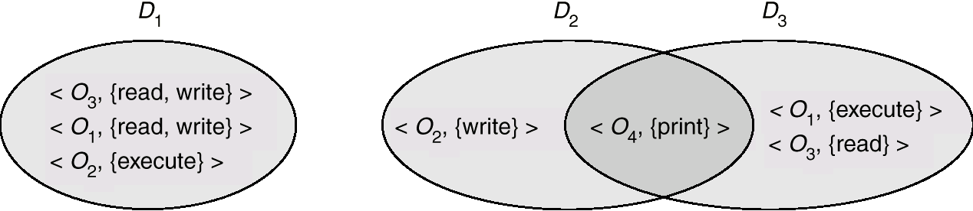
Domain Structure
Access-right = <object-name, rights-set>
where rights-set is a subset of all valid operations that can be performed on the object.
Domain = set of access-rights
Dr. Hitendra Garg, Professor, GLA University

Slide 44
Domain Implementation (UNIX)
System consists of 2 domains:
  User
  Supervisor
Dr. Hitendra Garg, Professor, GLA University

Slide 45
Access Matrix
View protection as a matrix (access matrix)
Rows represent domains
Columns represent objects
Access(i, j) is the set of operations that a process executing in Domain_{i} can invoke on Object_{j}
Dr. Hitendra Garg, Professor, GLA University

Slide 46
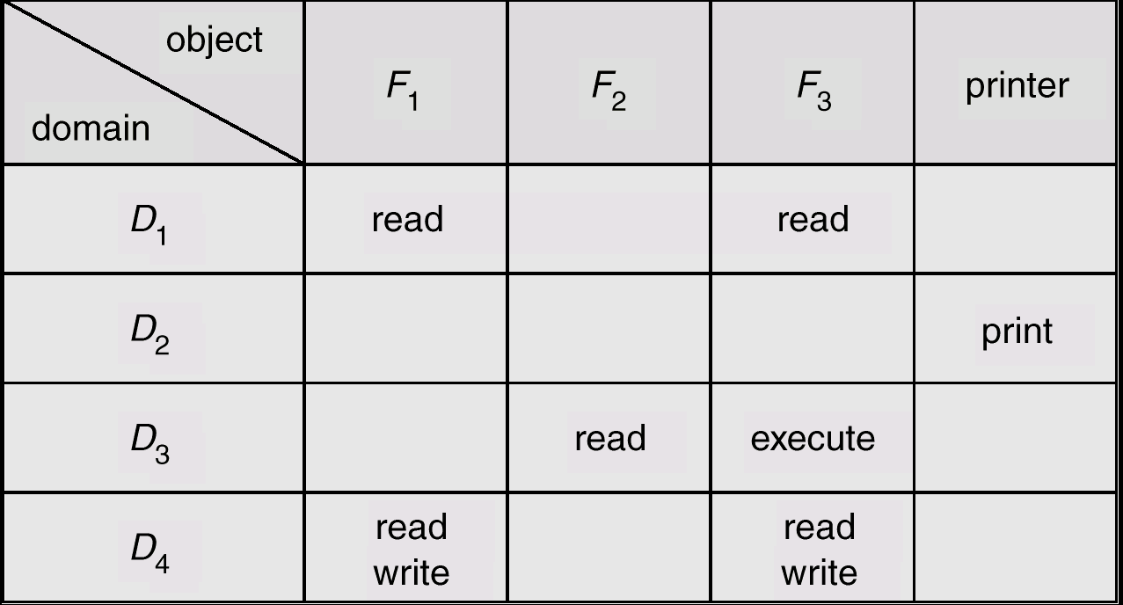
Access Matrix
Figure A
Dr. Hitendra Garg, Professor, GLA University

Slide 47
Use of Access Matrix
If a process in Domain D_{i} tries to do “op” on object O_{j}, then “op” must be in the access matrix.
Can be expanded to dynamic protection.
  Operations to add, delete access rights.
  Special access rights:
    owner of O_{i}
    copy op from O_{i} to O_{j}
    control – D_{i} can modify D_{j} access rights
    transfer – switch from domain D_{i} to D_{j}
Dr. Hitendra Garg, Professor, GLA University

Slide 48
Use of Access Matrix (Cont.)
Access matrix design separates mechanism from policy.
  Mechanism
    Operating system provides access-matrix + rules.
    If ensures that the matrix is only manipulated by authorized agents and that rules are strictly enforced.
  Policy
    User dictates policy.
    Who can access what object and in what mode.
Dr. Hitendra Garg, Professor, GLA University

Slide 49
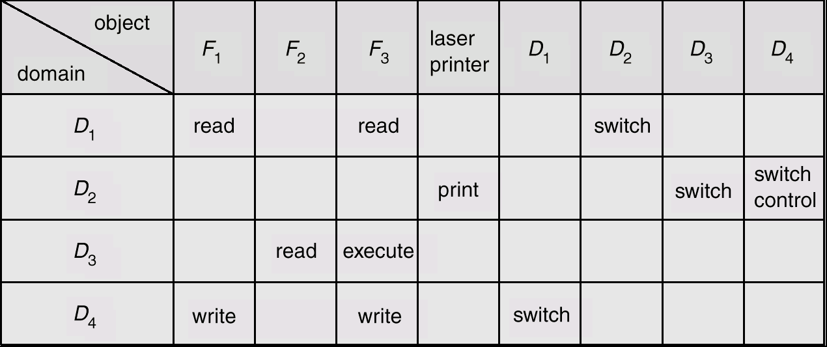
Modified Access Matrix
Dr. Hitendra Garg, Professor, GLA University

